Slide 1
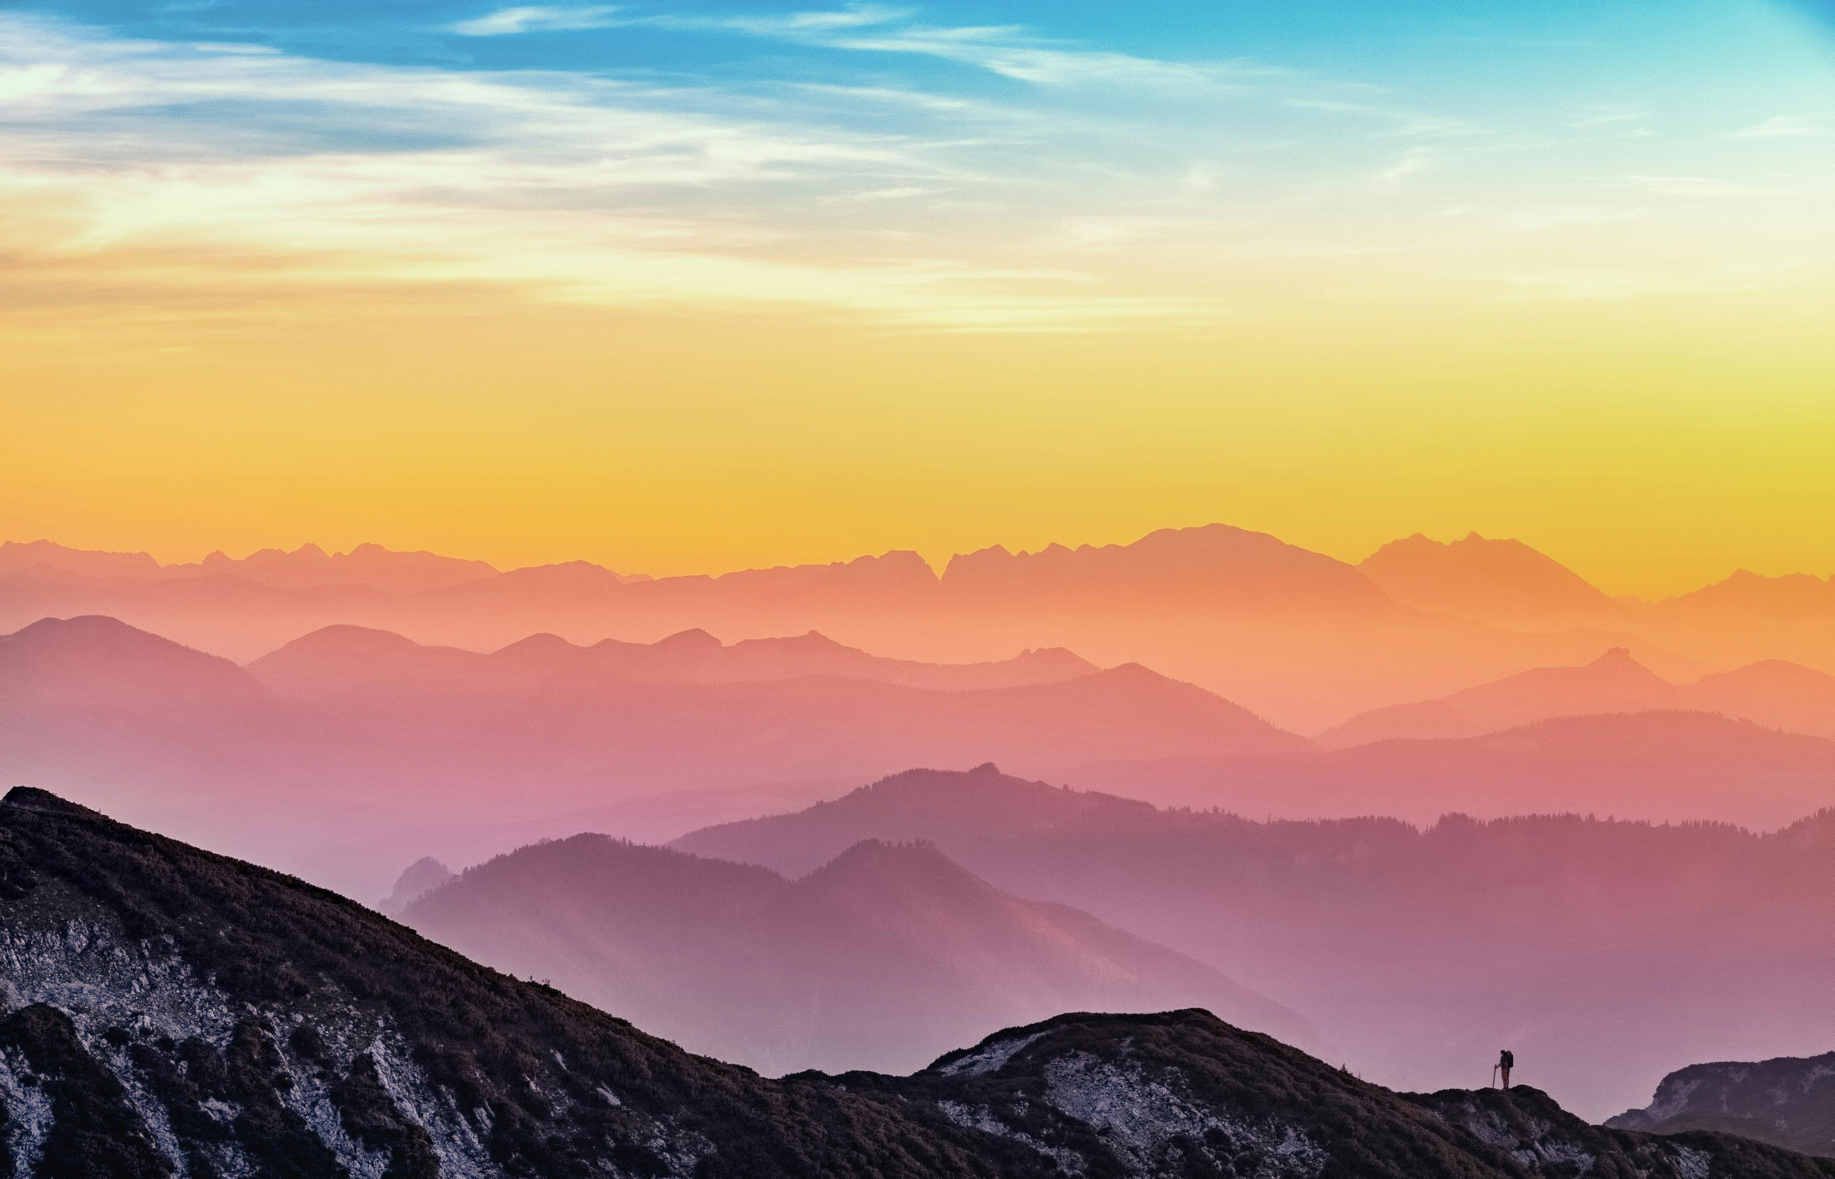
Mountain
The mountain stands tall like a giant in the sky, its snowy crown glowing in the sunlight. Rivers dance down its sides like silver threads, and the wind hums a gentle song through pine-covered slopes. Clouds gather near its peak, whispering secrets only the sky can hear.

